Slide 1
AVL-Trees

Slide 2
Balanced binary tree
The disadvantage of a binary search tree is that its height can be as large as N-1
This means that the time needed to perform insertion and deletion and many other operations can be O(N) in the worst case
We want a tree with small height
A binary tree with N node has height at least Θ(log N)
Thus, our goal is to keep the height of a binary search tree O(log N)
Such trees are called balanced binary search trees. Examples are AVL tree, red-black tree.

Slide 3
AVL tree
Height of a node
The height of a leaf is 1. The height of a null pointer is zero.
The height of an internal node is the maximum height of its children plus 1
Note that this definition of height is different from the one we defined previously (we defined the height of a leaf as zero previously).

Slide 4
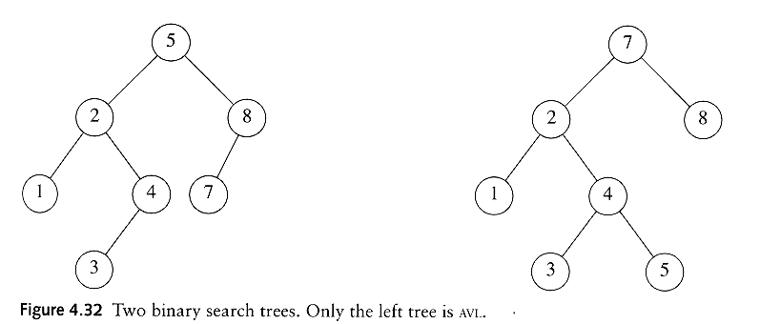
AVL tree
An AVL tree is a binary search tree in which
  for every node in the tree, the height of the left and right subtrees differ by at most 1.

Slide 5
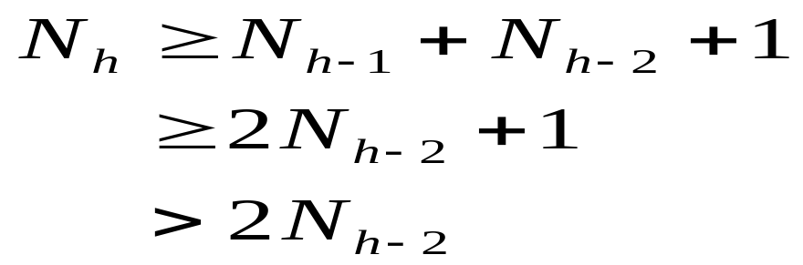
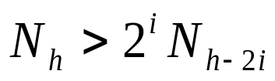
AVL tree
Let x be the root of an AVL tree of height h
Let N_{h} denote the minimum number of nodes in an AVL tree of height h
Clearly, N_{i} ≥ N_{i-1} by definition
We have
By repeated substitution, we obtain the general form
The boundary conditions are: N₁=1 and N₂ =2. This implies that h = O(log N_{h}).
Thus, many operations (searching, insertion, deletion) on an AVL tree will take O(log N) time.

Slide 6
Rotations
When the tree structure changes (e.g., insertion or deletion), we need to transform the tree to restore the AVL tree property.
This is done using single rotations or double rotations.
e.g. Single Rotation
y
x
x
y
C
A
C
B
B
A
Before Rotation
After Rotation

Slide 7
Rotations
Since an insertion/deletion involves adding/deleting a single node, this can only increase/decrease the height of some subtree by 1
Thus, if the AVL tree property is violated at a node x, it means that the heights of left(x) and right(x) differ by exactly 2.
Rotations will be applied to x to restore the AVL tree property.

Slide 8
Insertion
First, insert the new key as a new leaf just as in ordinary binary search tree
Then trace the path from the new leaf towards the root. For each node x encountered, check if heights of left(x) and right(x) differ by at most 1.
If yes, proceed to parent(x). If not, restructure by doing either a single rotation or a double rotation.
For insertion, once we perform a rotation at a node x, we won’t need to perform any rotation at any ancestor of x.

Slide 9
Insertion
Let x be the node at which left(x) and right(x) differ by more than 1
Assume that the height of x is h+3
There are 4 cases
  Height of left(x) is h+2 (i.e. height of right(x) is h)
    Height of left(left(x)) is h+1 ⇒ single rotate with left child
    Height of right(left(x)) is h+1 ⇒ double rotate with left child
  Height of right(x) is h+2 (i.e. height of left(x) is h)
    Height of right(right(x)) is h+1 ⇒ single rotate with right child
    Height of left(right(x)) is h+1 ⇒ double rotate with right child

Slide 10
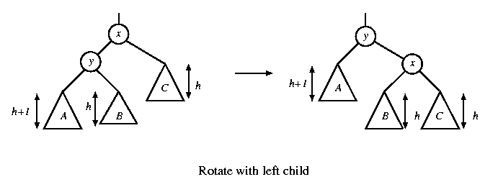
Single rotation
The new key is inserted in the subtree A.
The AVL-property is violated at x
height of left(x) is h+2
height of right(x) is h.

Slide 11
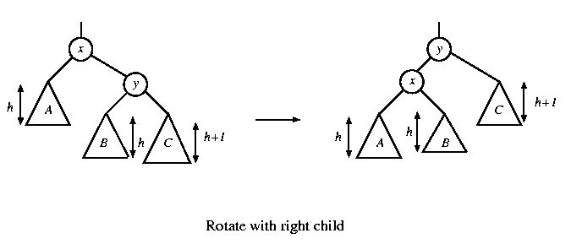
Single rotation
The new key is inserted in the subtree C.
The AVL-property is violated at x.
Single rotation takes O(1) time.
Insertion takes O(log N) time.

Slide 12
x
AVL Tree
5
5
y
8
C
3
3
8
1
4
B
1
4
A
0.8
Insert 0.8
3
5
1
After rotation
4
8
0.8

Slide 13
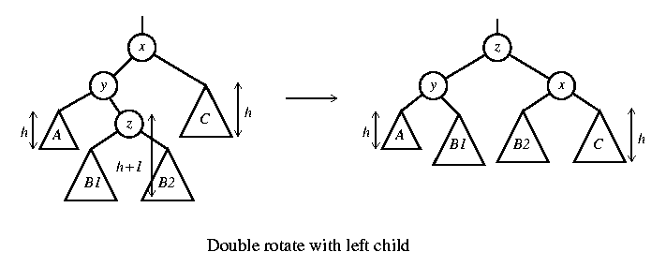
Double rotation
The new key is inserted in the subtree B1 or B2.
The AVL-property is violated at x.
x-y-z forms a zig-zag shape
also called left-right rotate

Slide 14
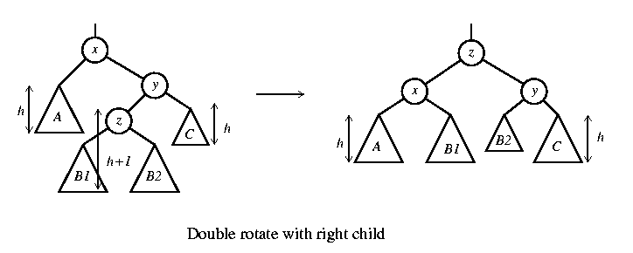
Double rotation
The new key is inserted in the subtree B1 or B2.
The AVL-property is violated at x.
also called right-left rotate

Slide 15
x
5
AVL Tree
5
C
y
8
3
3
8
A
1
4
z
1
4
B
3.5
Insert 3.5
4
5
3
3.5
8
After Rotation
1

Slide 16
Example
We’ve inserted 3, 2, 1, 4, 5, 6, 7, 16
We’ll insert 15, 14, 13, 12, 11, 10, 8, 9
4
4
2
6
2
6
1
3
5
7
k1
1
3
5
15
k2
16
k3
7
16
Double rotation
k1
k3
Insert 16, fine
Insert 15
violation at node 7
k2
15

Slide 17
4
4
2
6
k1
2
7
k2
A
1
3
5
15
k3
1
3
6
k1
15
k3
k2
7
16
D
5
14
16
Insert 14
14
C
Double rotation
4
k1
7
X
2
7
k2
4
15
1
3
6
15
2
6
14
16
Insert 13
5
14
16
1
3
5
13
Y
Z
Single rotation
13

Slide 18
7
7
4
15
4
15
2
6
14
16
2
6
13
16
1
3
5
13
1
3
5
12
14
Insert 12
12
Single rotation
7
7
4
13
4
15
2
6
12
15
2
6
13
16
1
3
5
11
14
16
1
3
5
12
14
Insert 11
Single rotation
11

Slide 19
7
7
4
13
4
13
2
6
12
15
2
6
11
15
1
3
5
11
14
16
1
3
5
10
12
14
16
Insert 10
10
Single rotation
7
7
4
13
4
13
2
6
11
15
2
6
11
15
1
3
5
9
12
14
16
1
3
5
10
12
14
16
8
10
8
Insert 8, fine
then insert 9
9
Double rotation

Slide 20

Insertion Analysis
logN
Insert the new key as a new leaf just as in ordinary binary search tree: O(logN)
Then trace the path from the new leaf towards the root, for each node x encountered: O(logN)
  Check height difference: O(1)
  If satisfies AVL property, proceed to next node: O(1)
  If not, perform a rotation: O(1)
The insertion stops when
  A rotation is performed
  Or, we’ve checked all nodes in the path
Time complexity for insertion O(logN)

Slide 21
Deletion
Delete a node x as in ordinary binary search tree. Note that the last node deleted is a leaf.
Then trace the path from the new leaf towards the root.
For each node x encountered, check if heights of left(x) and right(x) differ by at most 1. If yes, proceed to parent(x). If not, perform an appropriate rotation at x. There are 4 cases as in the case of insertion.
For deletion, after we perform a rotation at x, we may have to perform a rotation at some ancestor of x. Thus, we must continue to trace the path until we reach the root.

Slide 22
Deletion
On closer examination: the single rotations for deletion can be divided into 4 cases (instead of 2 cases)
  Two cases for rotate with left child
  Two cases for rotate with right child

Slide 23
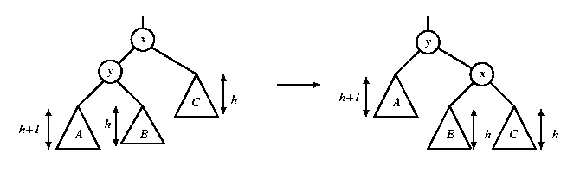
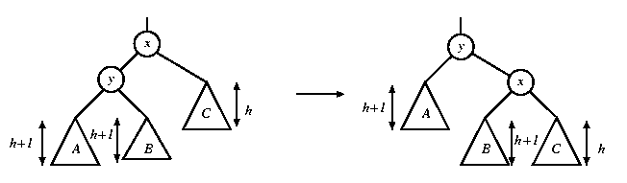
Single rotations in deletion
In both figures, a node is deleted in subtree C, causing the height to drop to h. The height of y is h+2. When the height of subtree A is h+1, the height of B can be h or h+1. Fortunately, the same single rotation can correct both cases.
rotate with left child

Slide 24
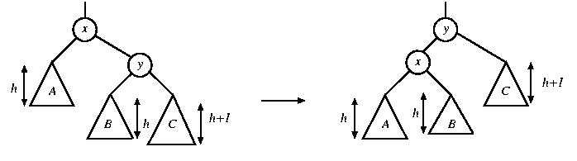
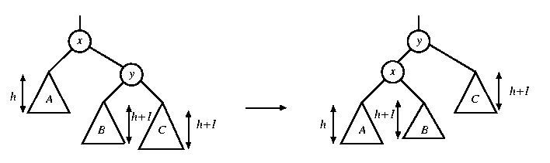
Single rotations in deletion
In both figures, a node is deleted in subtree A, causing the height to drop to h. The height of y is h+2. When the height of subtree C is h+1, the height of B can be h or h+1. A single rotation can correct both cases.
rotate with right child

Slide 25
Rotations in deletion
There are 4 cases for single rotations, but we do not need to distinguish among them.
There are exactly two cases for double rotations (as in the case of insertion)
Therefore, we can reuse exactly the same procedure for insertion to determine which rotation to perform

Slide 26
Deletion Example 1
20
20
10
35
15
35
5
15
25
40
10
18
25
40
18
30
38
45
30
38
45
50
50
Single Rotation
Delete 5, Node 10 is unbalanced

Slide 27
Cont’d
20
35
15
35
20
40
10
18
25
40
15
25
38
45
30
38
45
10
18
30
50
50
Continue to check parents
Oops!! Node 20 is unbalanced!!
Single Rotation
For deletion, after rotation, we need to continue tracing upward to see if AVL-tree property is violated at other node.

Slide 28
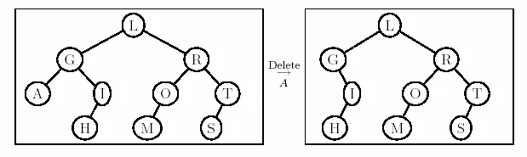
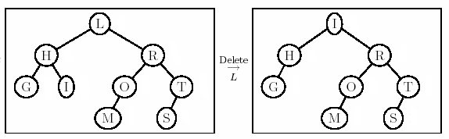
Deletion Example 2
Right most child of left subtree = I
Double rotation
Ok here!

Slide 29
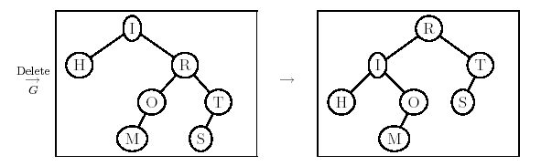
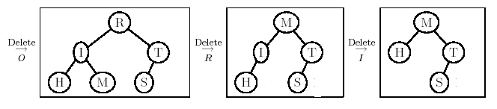
Example 2 Cont’d
New case

